Slide 1
Cingular GPRS Experiments
Andrew Parker
Chris Mar

Slide 2
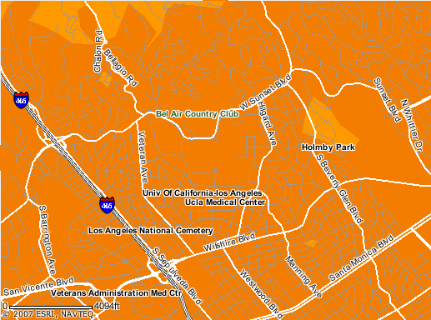

Where we tested

Slide 3
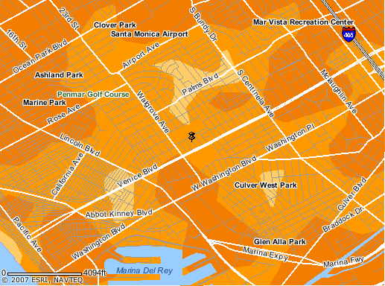

Slide 4

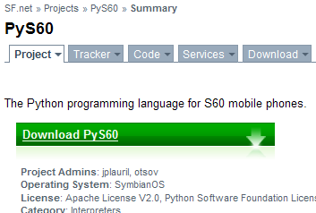

Slide 5
Different file sizes:
  1k, 10k, 50k, 100k

Slide 6
Where and when did we collect data?

Slide 7
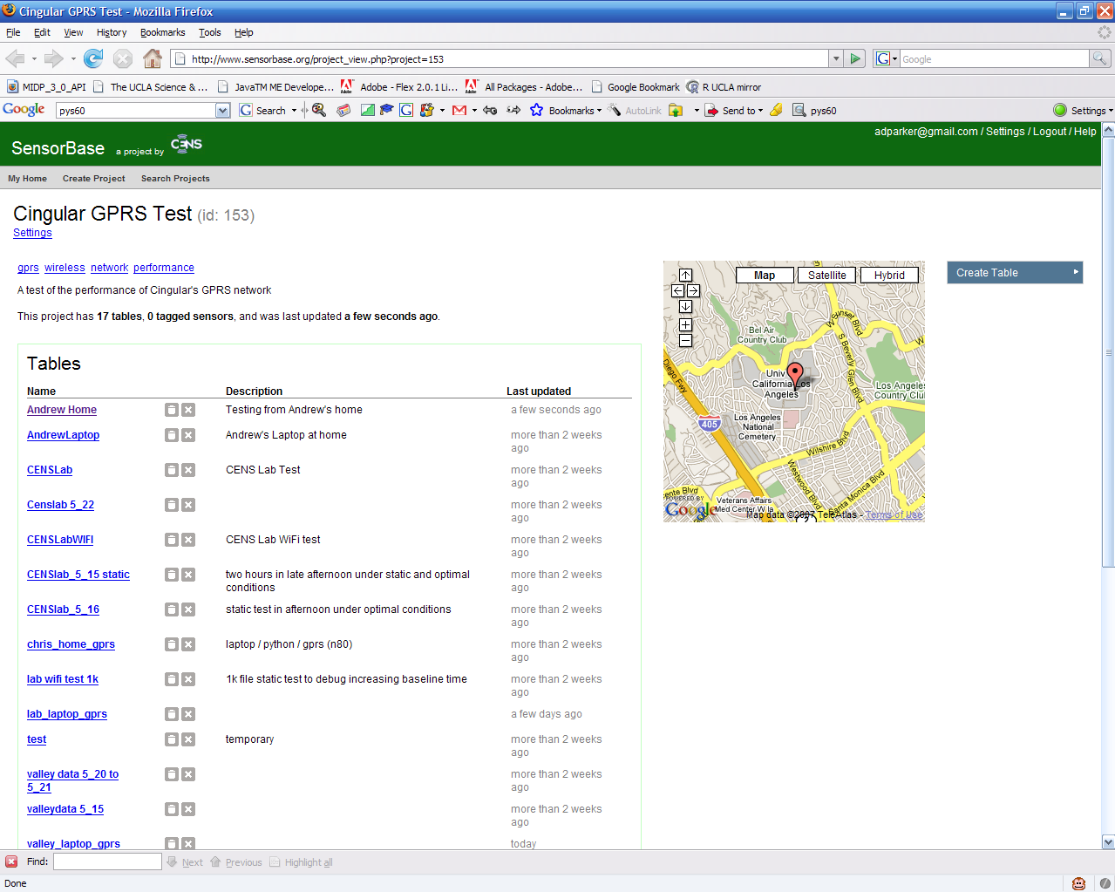

Slide 8
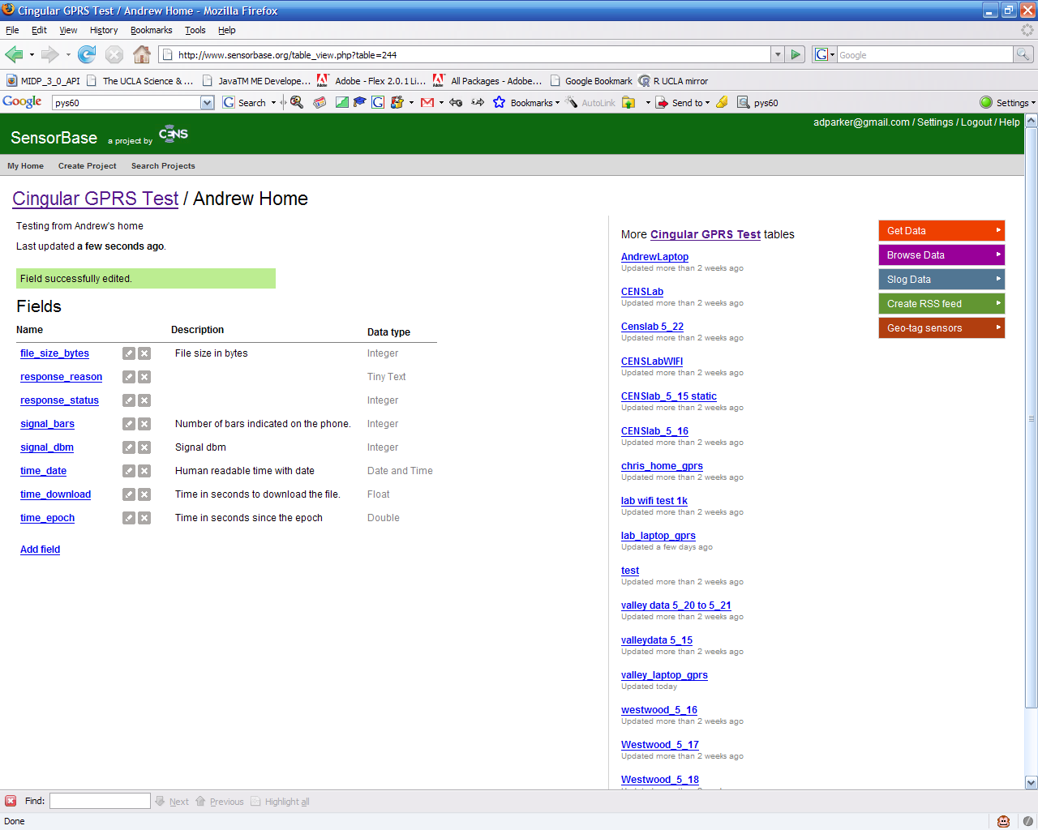

Slide 9
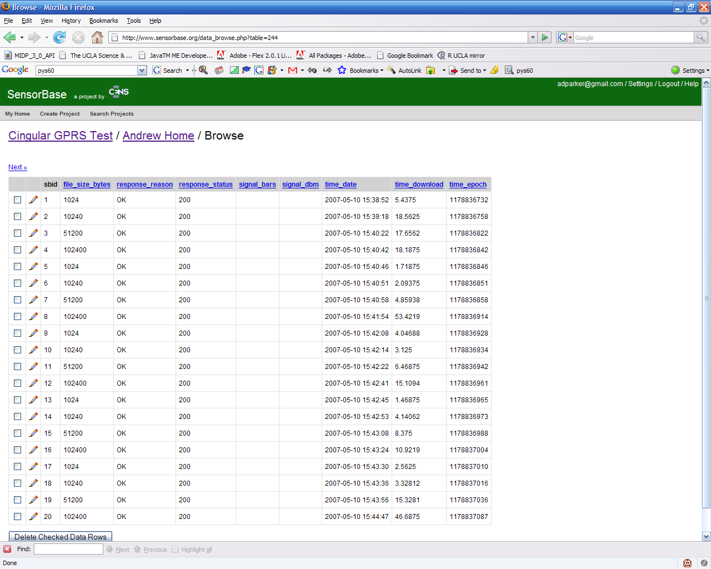

Slide 10
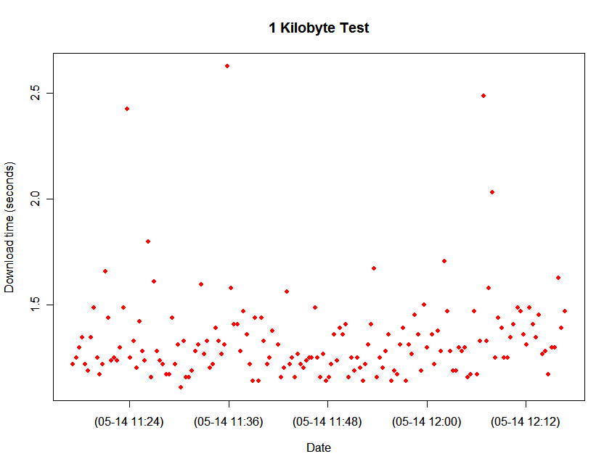
Our first experiment
Notes:
Here’s our first experiment at CENS Lab for about one hour.

Slide 11
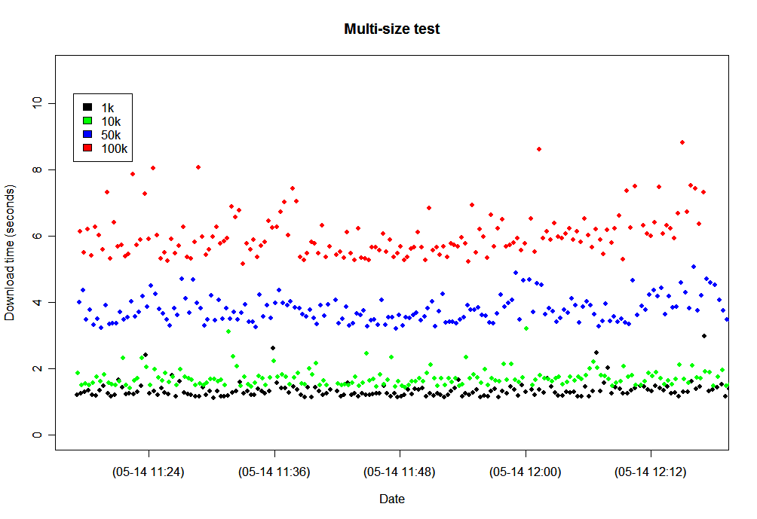

Slide 12
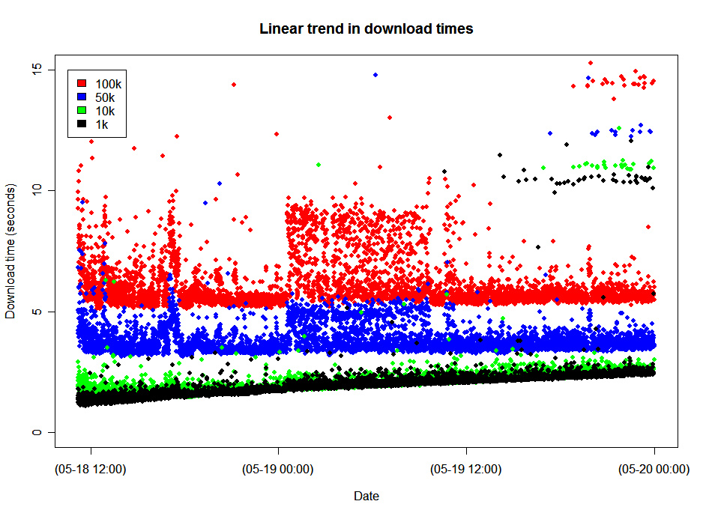

Slide 13
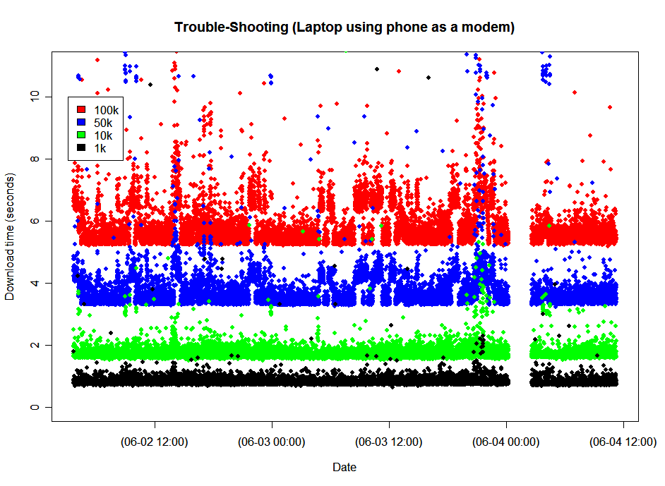
Notes:
Linear trend is not a network thing. Here’s data over 48 hours. But we’re using “old” data because we need the signal strength, couldn’t afford to tie-up a computer.

Slide 14
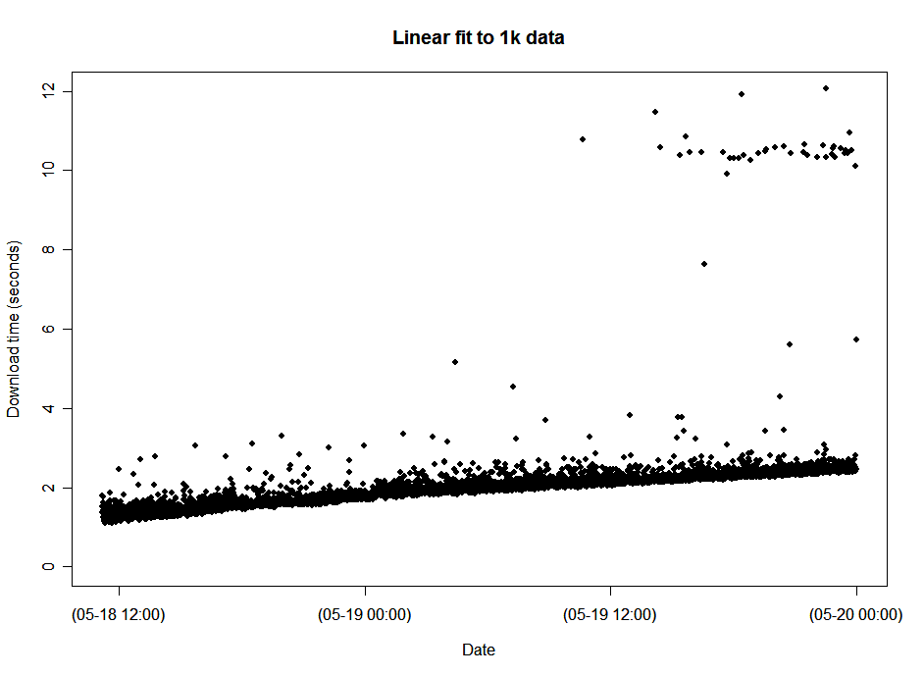

Slide 15
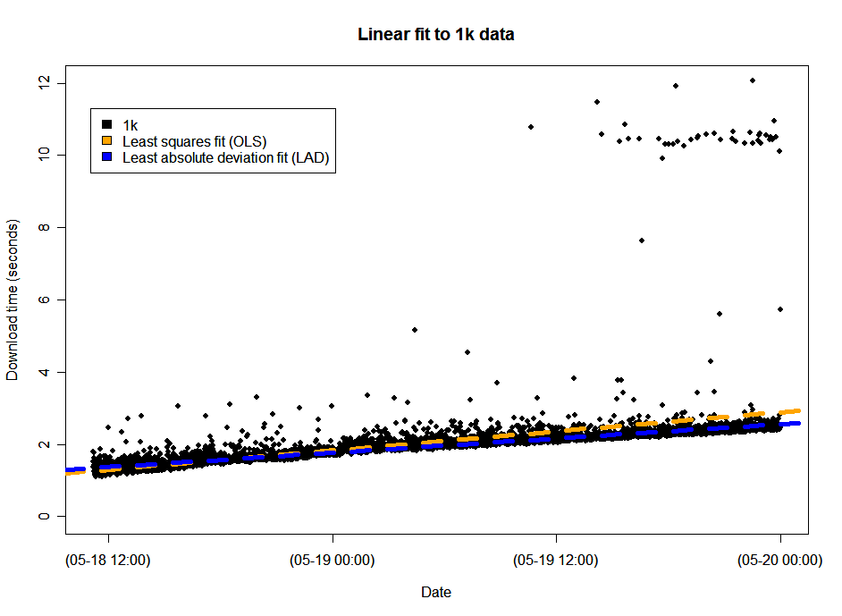

Slide 16
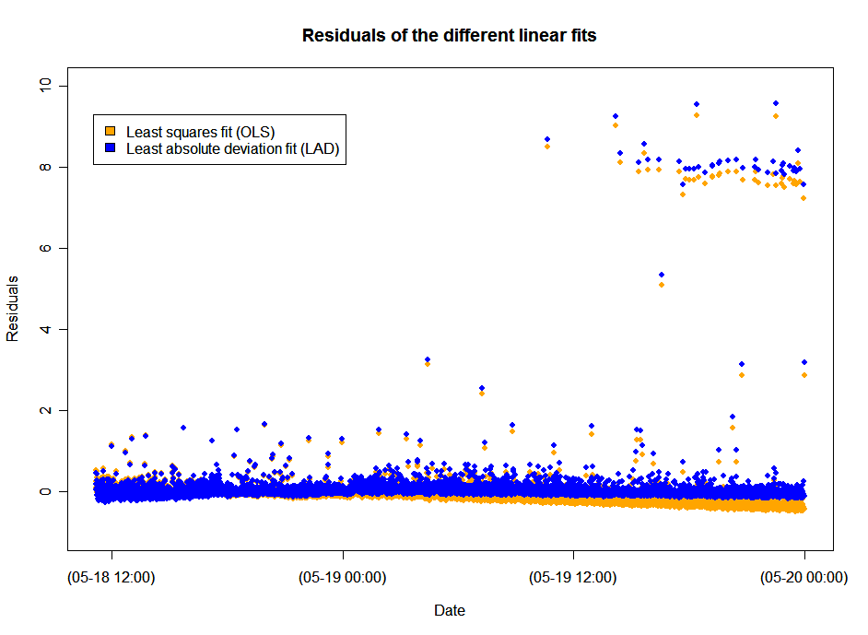
Notes:
Note how OLS dives down as a result of the “outliers”. This is not what we want.

Slide 17
Least Absolute Deviation Coefs.
File size | Slope Est. | Std. Err.
1k | 0.79378 | 0.00440
10k | 0.72159 | 0.00582
50k | 0.11004 | 0.01733
100k | -0.04931 | 0.01955

Slide 18
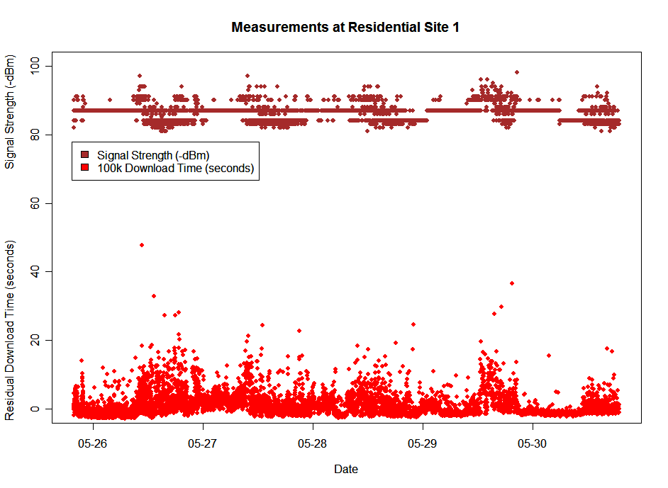
Notes:
Should use data on or after 5-14. It looks funny that we’re going backwards.

Slide 19
